Slide 2
Quiz Begins at 9am sharp

Slide 3
Objectives
Knowledge:
How do we plan a complex program?
How do we use documentation?
Skills:
Analyze complex image arrangements.
Plan composition of image expressions.

Slide 4
Agenda
Quiz 10 minutes
The car program (whole class) 20 minutes
Finish HW (now graded) 30 minutes

Slide 5
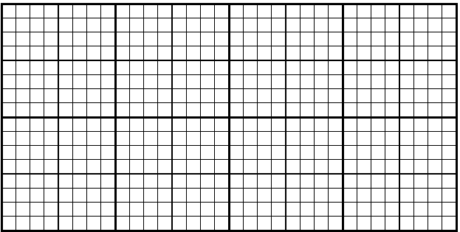
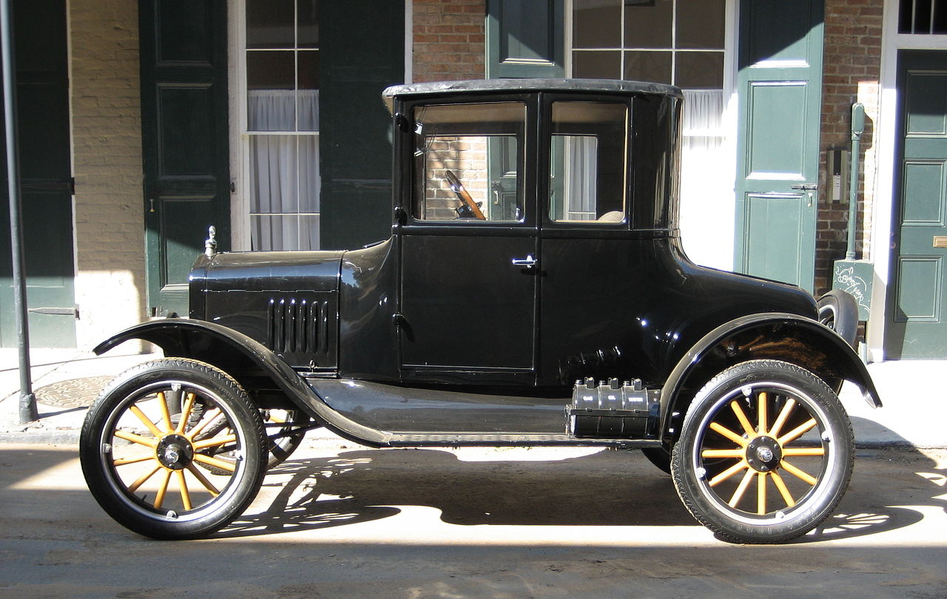
Draw a sketch

Slide 6
Make a scale drawing

Slide 7
Which functions?

